Slide 1
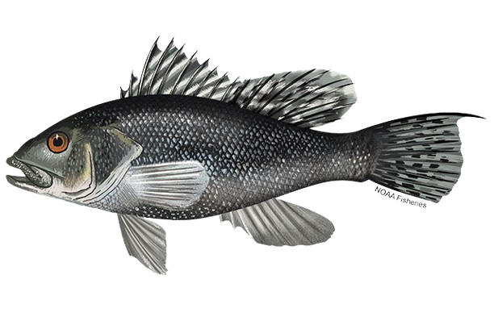
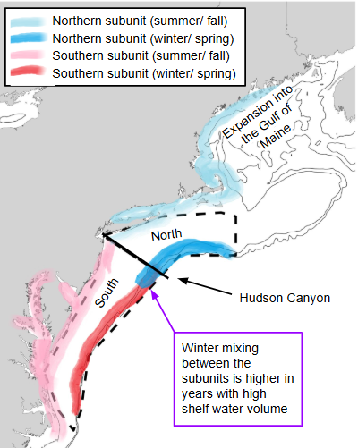
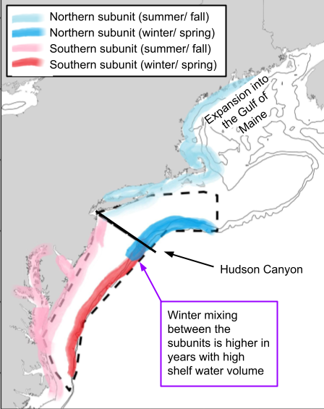
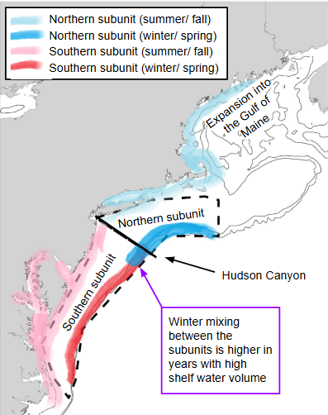
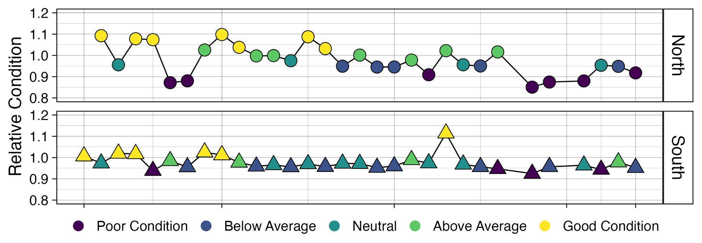
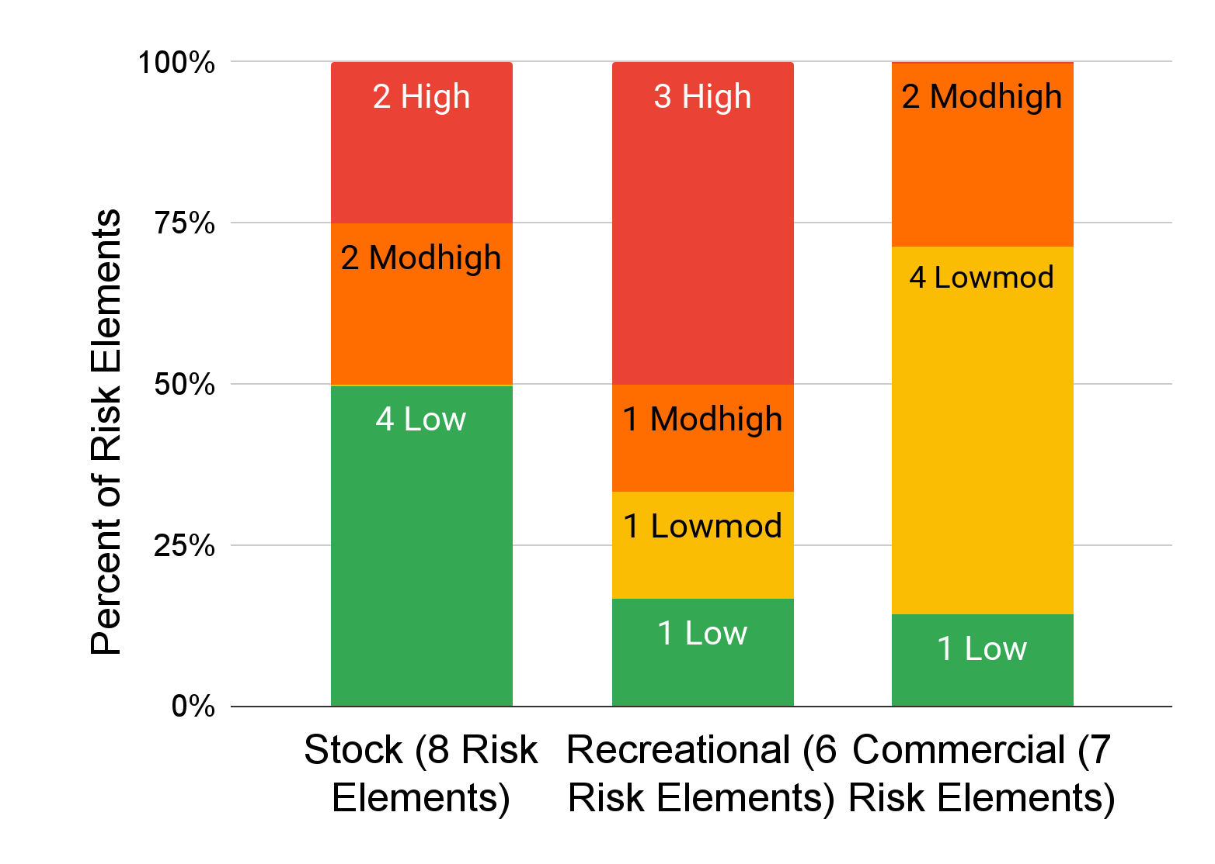
Black Sea Bass (Centropristis striata)
Ecosystem & Socioeconomic Profile Report Card
Spring 2025
Black sea bass is an important Mid-Atlantic stock with high commercial value and recreational engagement. There are two stock subunits, divided at the Hudson Canyon. Overfishing is not occurring and the stock is not overfished. The stock assessment model uses winter bottom temperature as a recruitment covariate to incorporate the observed link between cold temperature and smaller year classes.
2024 IN REVIEW
Fishing Community Observations:
Steady or increasing availability
Expanding distributions and changes in migration timing
Local regulatory complexity affects fishing opportunities
Commercial Fishery:
Number of active vessels declined in 2024, but total landings increased from 2023
Total revenue decreased slightly along with average prices ($/lb)
Average revenue per vessel increased, following an upward trend over the past three years for vessels that remain in the fishery
Recreational Fishery:
Number of targeted trips, catch, and landings all down from 2023
But number of trips still above the historic average
Not clear if catch per angler has continued to increase in 2024
Ecosystem:
Cold winter in the north but near average in the south
Poor or below average fish condition in recent years
KEY POINTS FROM THE MID-ATLANTIC RISK ASSESSMENT
According to the Mid-Atlantic 2024 EAFM risk assessment update, Black Sea Bass scored high and/or moderately high risk in the following elements:
Moderate-high to high risk to the stock due to:
Very high exposure to changes in climate
Observed and potential changes in distribution; northward shift into the Gulf of Maine
Dependence on threatened estuarine habitat
Decline in the biomass of benthic invertebrate prey
Decline in black sea bass body condition in the Mid Atlantic Bight
High risk to the recreational fishery due to:
Catch exceeding harvest limits in several years
High regulatory complexity; frequent changes and varying interstate regulations; regulatory changes in allocations
Moderate-high risk to the commercial fishery due to:
Commercial revenue in wind development areas
High discards & discard mortality
U.S. Department of Commerce | National Oceanic and Atmospheric Administration | National Marine Fisheries Service | Northeast Fisheries Science Center

Slide 2
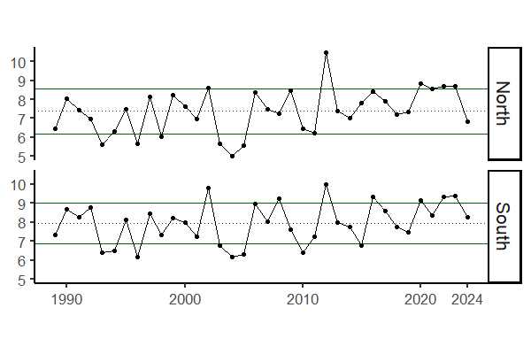
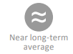
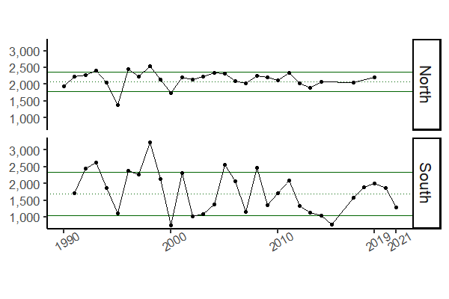


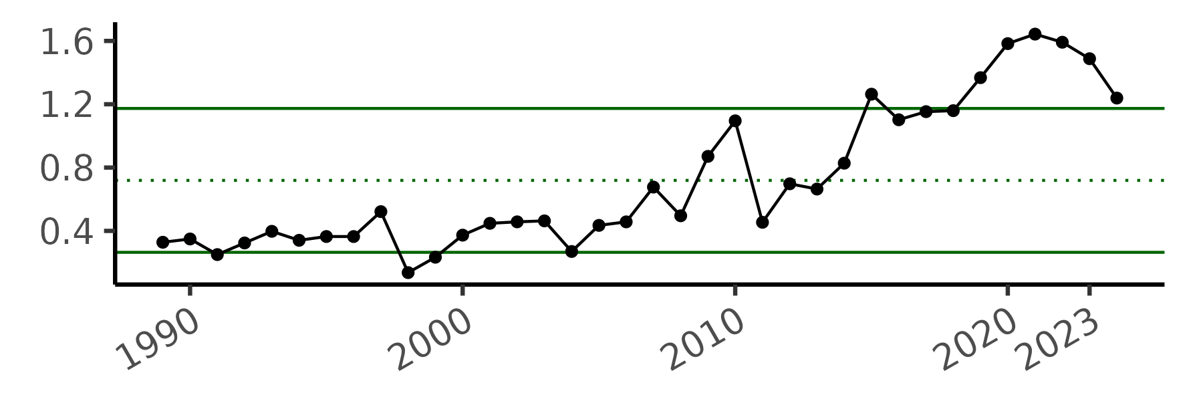
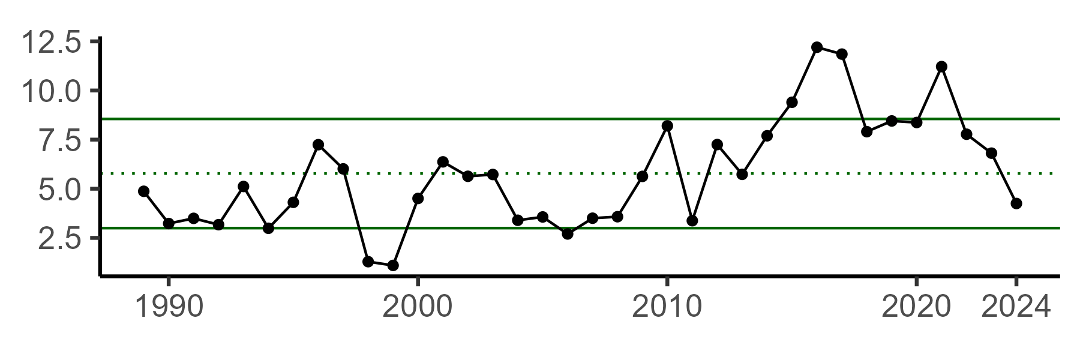
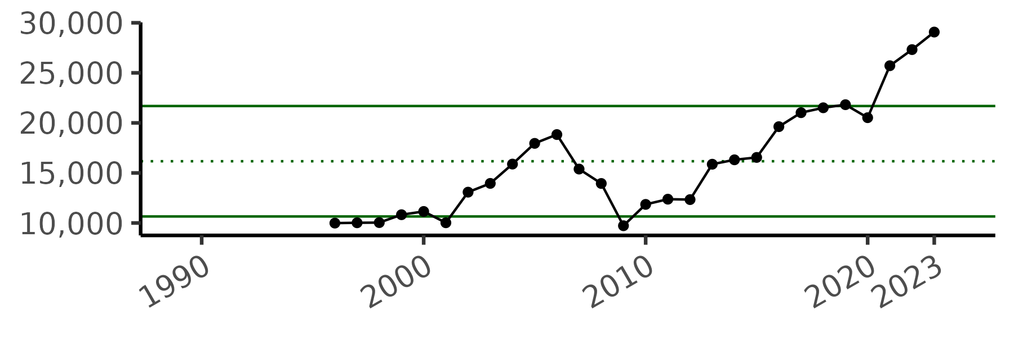
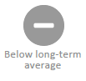
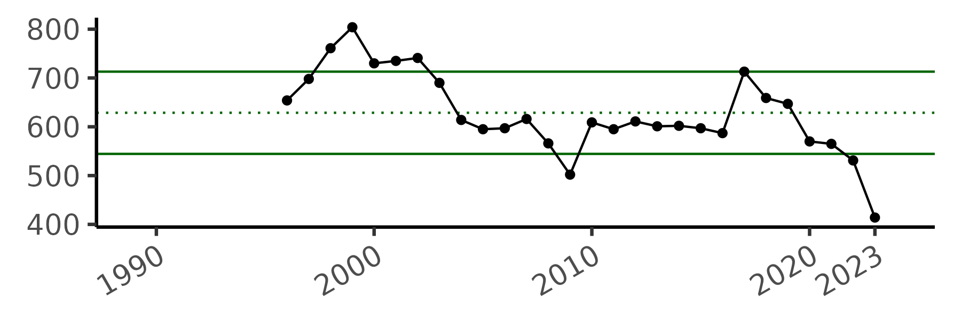
Indicator (units) | Status in 2024 | Implications | Time Series
Mean winter (Feb-Mar) bottom temperature (°C) Northern subunit: North of Hudson Canyon Southern subunit: South of Hudson Canyon | North: | Cold winter temperatures may increase the mortality of young-of-the-year fish, resulting in smaller year classes. Additionally, cold temperatures can cause northern fish to move into the southern subregion, leading to potential misallocation of catch between the northern and southern stock subunits. 2024 temperature in the northern subunit (north of Hudson Canyon) was colder than black sea bass's lower threshold of 8C. Bottom temperature data comes from GLORYS, a modeled product.
Shelf water volume (km³) Northern subunit: North of Hudson Canyon Southern subunit: South of Hudson Canyon | N/A (no data for 2024) | Shelf water volume is a proxy for suitable winter habitat; higher shelf water volume indicates less suitable habitat, potentially leading to northern fish migrating into the southern subregion. The shelf water volume dataset is created from in situ data, and there has been no winter sampling since 2021, highlighting the need for additional indicators to inform stock subunit mixing.
MRIP recreational trips (millions of annual trips) | Above long term average | Recent trip numbers are near an all-time high, but may have decreased from 2023 (2024 data is preliminary and does not include November and December 2024). Catch (not shown) generally reflects trip patterns. High regulatory complexity is likely contributing to recreational fishing trends.
MRIP recreational landings (millions of lbs.) |  | The recreational black sea bass fishery has a catch-and-release component, and management measures are being implemented to reduce recreational harvest. 2024 data is preliminary and does not include November and December 2024.
Commercial revenue per vessel (2023 USD) | Above long term average | Commercial revenue per vessel has an overall increasing trend, suggesting potentially favorable returns in the fishery, despite decreases in both total landings and average price ($/lb.; not shown).
Number of commercial vessels (#) |  | The number of active vessels has been decreasing since 2017, which could impact revenue distributions and fleet composition.
Below threshold
South:
Please contact nefsc.esp.leads@noaa.gov with any questions or comments.
U.S. Department of Commerce | National Oceanic and Atmospheric Administration | National Marine Fisheries Service | Northeast Fisheries Science Center

Slide 3
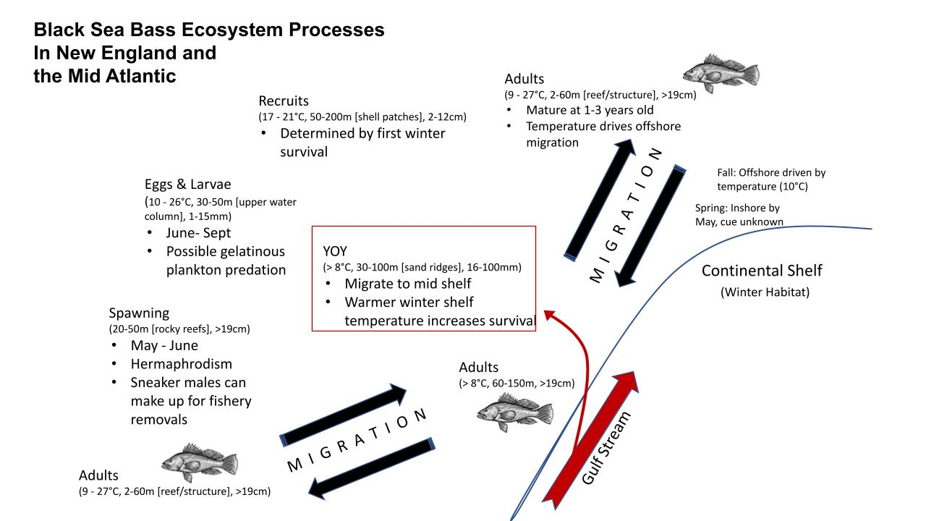
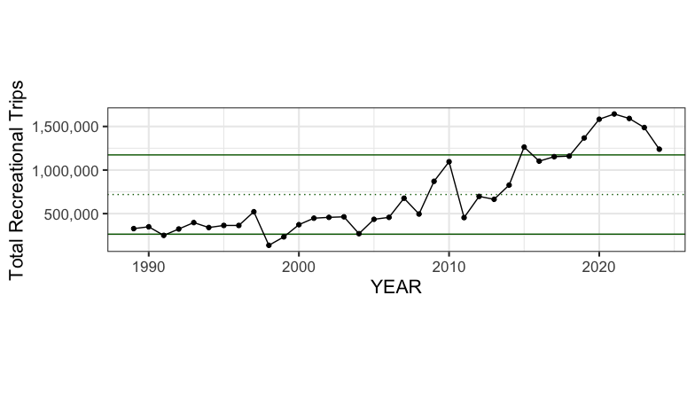
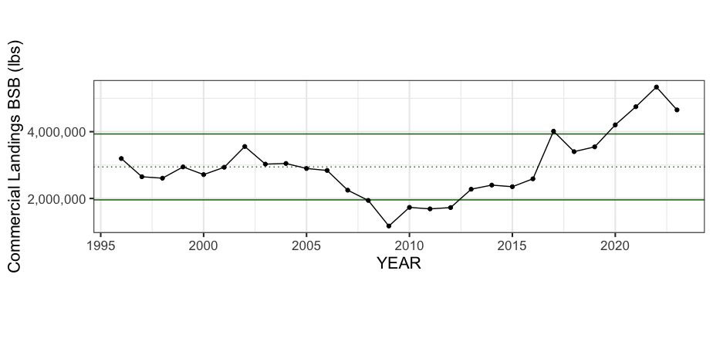
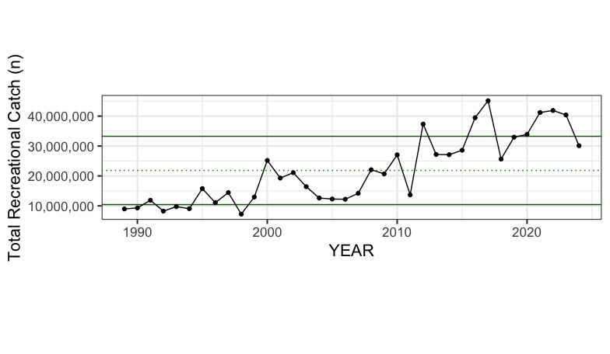
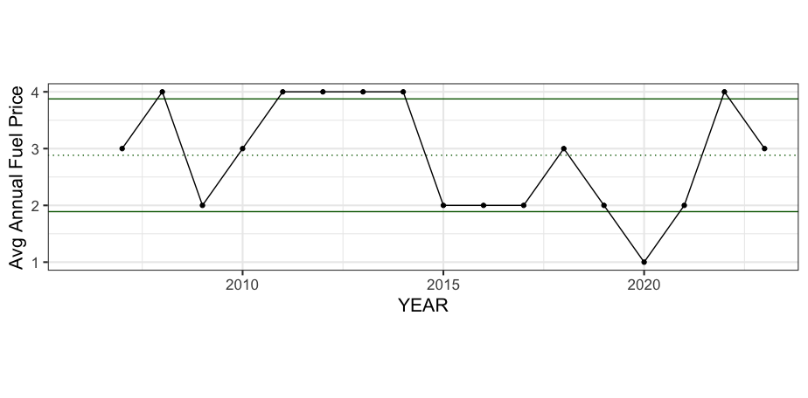
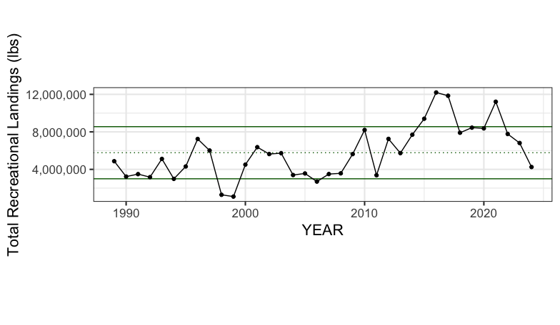
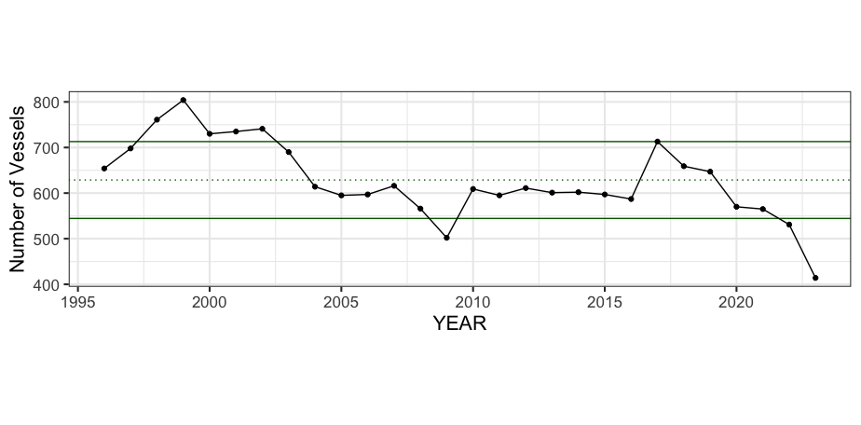
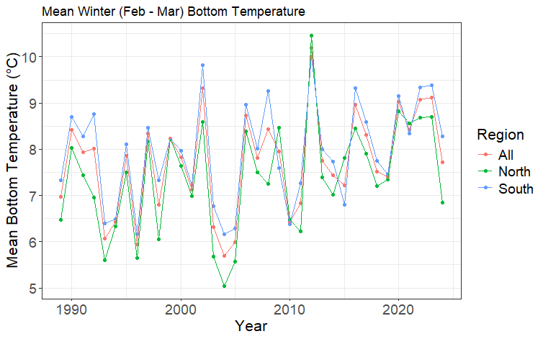
Black Sea Bass (Centropristis striata)
Stock highlights: Two stocks (Mid-Atlantic, South Atlantic), shifting distribution, high value
CONCEPTUAL MODEL
Northeast Fisheries Science Center
INDICATORS
BACKGROUND
Spawning
Protogynous hermaphrodites
April:October
Eggs
Pelagic, peak densities ~30 meters
Temperature dependent incubation
Peak densities July:Sept
Temperature: 16-22°C
Larvae
Absorb yolk sac after hatching (2-6 days)
Planktonic until reach 10-16mm
Juveniles
Settle ~13-24 mm
Growth rate: 0.32 - 1.22 mm/day during first year
High mortality rates in first winter post-hatch
Adults
Generalist benthivorous
Maturity: age 1-3
Female lifespan ~ 8 years
Male lifespan ~ 12 years
Habitat
Optimal temperature: 8-10 °C
Optimal salinity: 33-35 psu
Complex structured habitats
Offshore in fall
Inshore in spring
U.S. Department of Commerce | National Oceanic and Atmospheric Administration | National Marine Fisheries Service

Slide 4
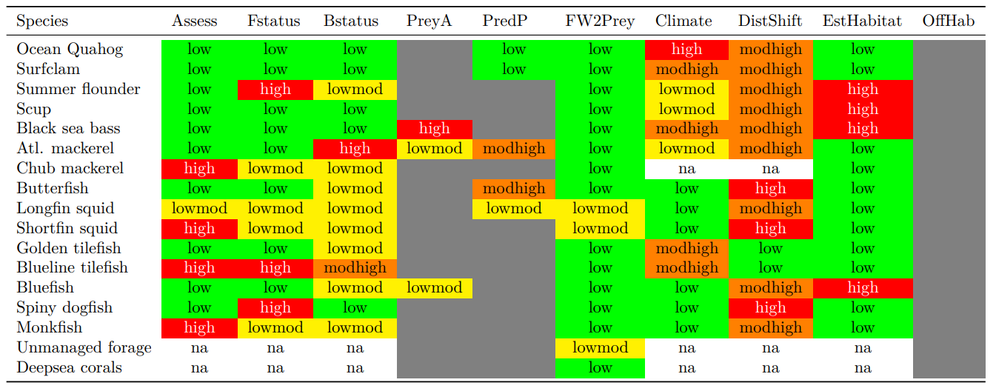
MANAGEMENT CONSIDERATIONS (RISK)
Moderate high in two risk elements (Climate, DistShift), which indicate high vulnerability to climate and high potential for shifting distributions
MODEL CONSIDERATIONS
Information relevant to assessment model assumptions or considerations
DATA GAPS AND FUTURE RESEARCH PRIORITIES
Identification of gaps in data and make recommendations for future research, data collection, and indicator methodology.
U.S. Department of Commerce | National Oceanic and Atmospheric Administration | National Marine Fisheries Service

Slide 5
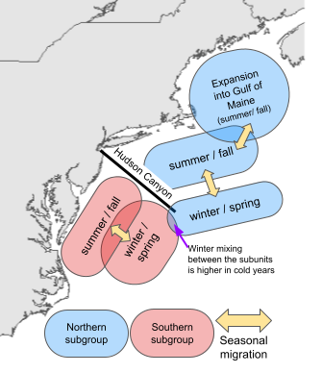
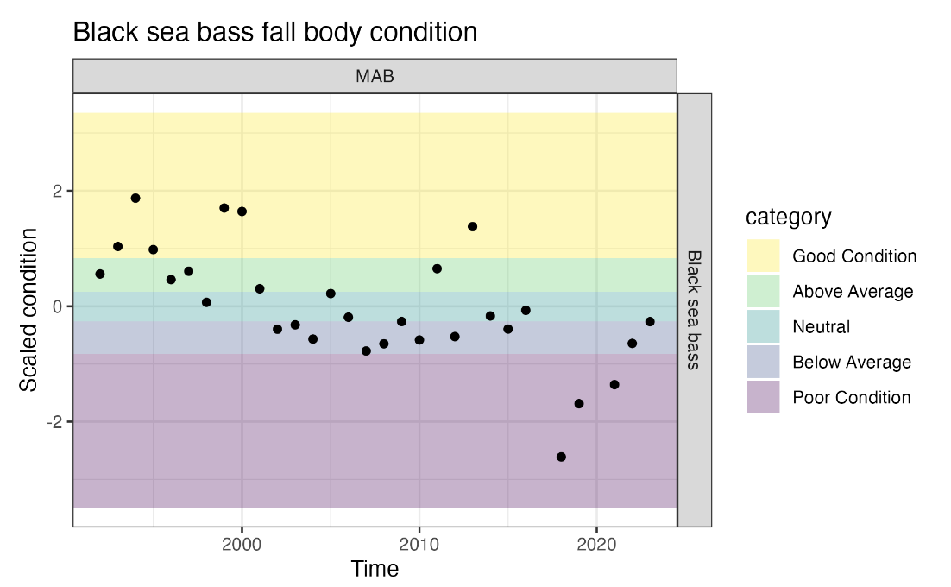
Black Sea Bass (Centropristis striata)
ECOSYSTEM INFLUENCES
Northeast Fisheries Science Center
Cold winter temperatures during the first year of life are associated with smaller year classes due to higher mortality
Recent warm temperatures may be promoting migration into the Gulf of Maine
Cold winter temperatures reduce the amount of suitable habitat, which may lead to mixing between the northern and southern subunits
HIGHLIGHTS
Two stock subunits
Shifting distribution
High commercial value & recreational engagement
STOCK STATUS
Overfishing is not occurring and the stock is not overfished
Assessment model passed peer review using high quality data with a small retrospective pattern
MANAGEMENT CONSIDERATIONS (RISK)
Moderate high in two risk elements (Climate, DistShift), which indicate high vulnerability to climate and high potential for shifting distributions
High risk of not achieving optimal yield due to threats to estuarine and nearshore coastal habitat/nursery grounds (EstHabitat) because BSB are estuarine dependent and their estuarine condition is poor
High prey availability risk (PreyA), which indicates either correlated trends in condition between BSB and their prey or poor fish condition and high dependence on prey with limited and declining availability
High risk in the recreational fishery due to inadequate control (FControl), complexity (RegComplex), and spatial mismatch of stocks and management (Allocation)
U.S. Department of Commerce | National Oceanic and Atmospheric Administration | National Marine Fisheries Service

Slide 6
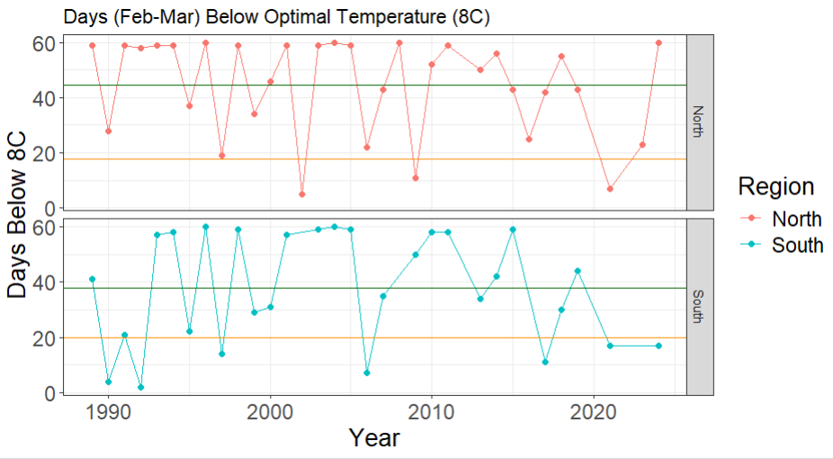
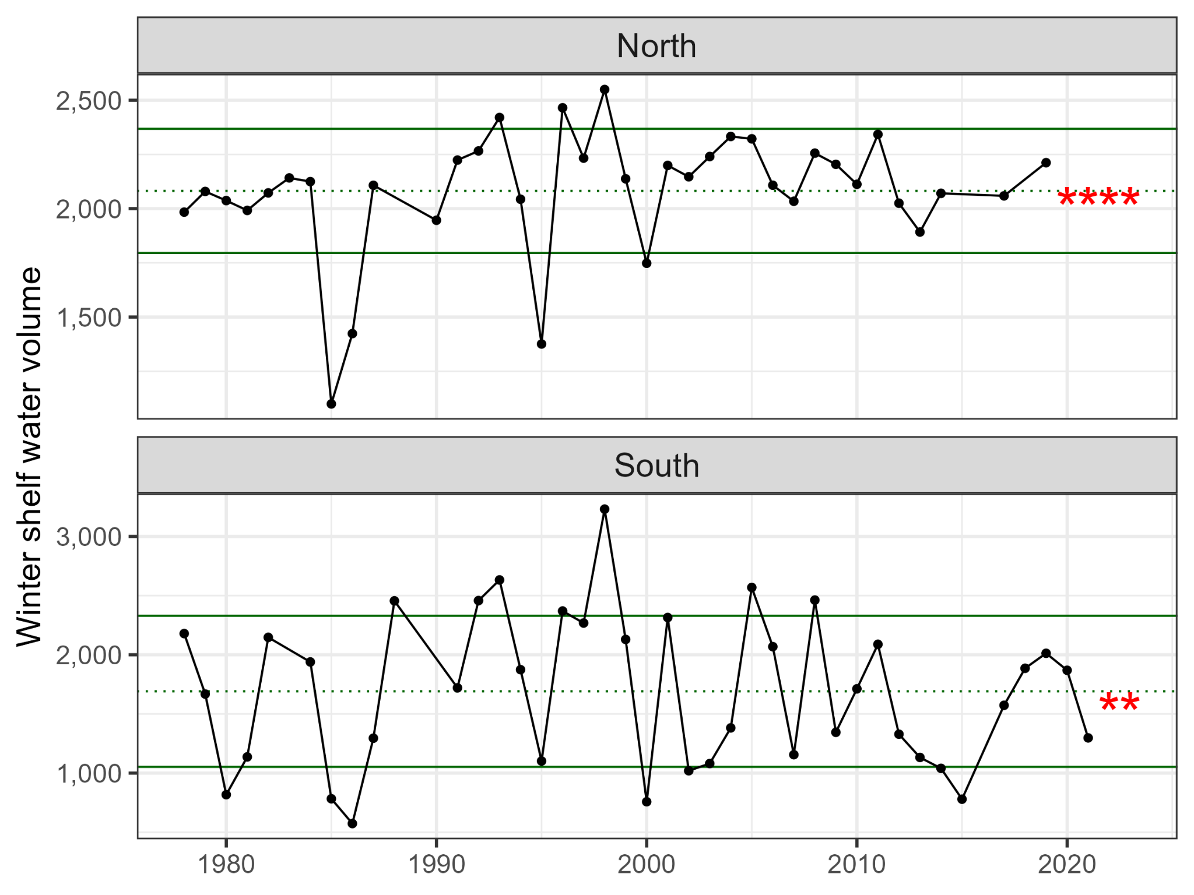
Socioeconomic
INDICATORS
Ecosystem
IMPORTANCE or INTERPRETATION
Lower mean winter bottom temperature may negatively impact recruitment
Winter shelf water volume data not available since 2021 (South) and 2019 (North) (red asterisk)
Caveats with data sources used to create indicators
Tie back to overwintering survival and shelf water volume/mixing concerns in original ESP
DATA GAPS AND FUTURE RESEARCH PRIORITIES
Identification of gaps in data and make recommendations for future research, data collection, and indicator methodology.
define better response variable to measure (indicator) the extent of winter mixing and the movement of northern fish to areas south of Hudson Canyon
Do not have most recent years for SWV data
U.S. Department of Commerce | National Oceanic and Atmospheric Administration | National Marine Fisheries Service

Slide 7
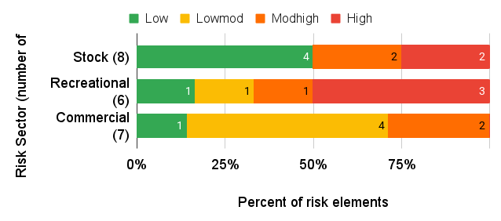
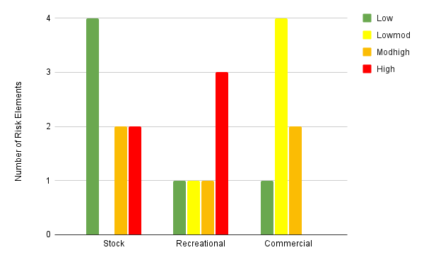
Black Sea Bass (Centropristis striata)
Ecosystem & Socioeconomic Report Card
March 2025
Northeast Fisheries Science Center
Indicator | Status in 2024 | Implications
Mean winter bottom temperature northern region | Cold: below 8C | Cold winter temperatures may increase the mortality of young-of-the-year fish, resulting in a smaller 2023 year class
Mean winter bottom temperature southern region | Neutral: above 8C | Combined with cold temperatures in the northern region, may result in northern fish moving into the southern region during winter, leading to misallocation of catch between the northern and southern stock subunits
Recreational trips | High: more than 1 SD above time series average | Important recreational fish
Recreational catch | Neutral/high: less than 1 SD above time series average | Important recreational fish
Recreational landings | Neutral/Low: less than 1 SD below time series average | Catch-and-release fishery
Commercial catch | High: more than 1 SD above time series average | Growing commercial value of black sea bass
Commercial vessels participating in fishery | Low: more than 1 SD below time series average | Black sea bass may be increasingly important for vessels that remain engaged in the fishery
ECOSYSTEM INFLUENCES
HIGHLIGHTS FROM THE MID-ATLANTIC RISK ASSESSMENT
High vulnerability to climate
High risk of changes to distributions; moving north into the Gulf of Maine
High risk of not achieving optimal yield due to threats to estuarine habitat
High prey availability risk (PreyA), which indicates either correlated trends in condition between BSB and their prey or poor fish condition and high dependence on prey with limited and declining availability
High risk to the recreational fishery due to catch exceeding Recreational Harvesting Limits in several years, regulatory complexity, and spatial mismatch of stocks and management
U.S. Department of Commerce | National Oceanic and Atmospheric Administration | National Marine Fisheries Service

Slide 8
INDICATORS
Socioeconomic
Ecosystem
DATA GAPS AND FUTURE RESEARCH PRIORITIES
define better response variable to measure (indicator) the extent of winter mixing and the movement of northern fish to areas south of Hudson Canyon
Do not have most recent years for SWV data
Caveats with data sources used to create indicators
U.S. Department of Commerce | National Oceanic and Atmospheric Administration | National Marine Fisheries Service

Slide 9
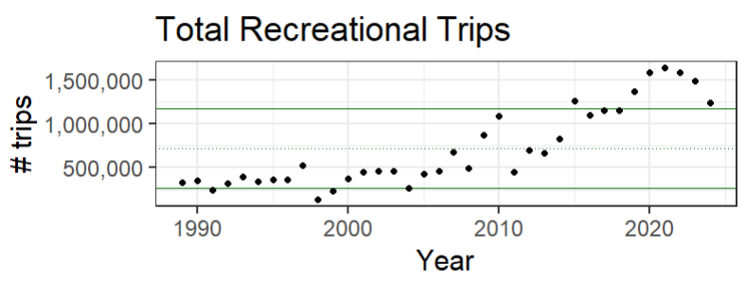
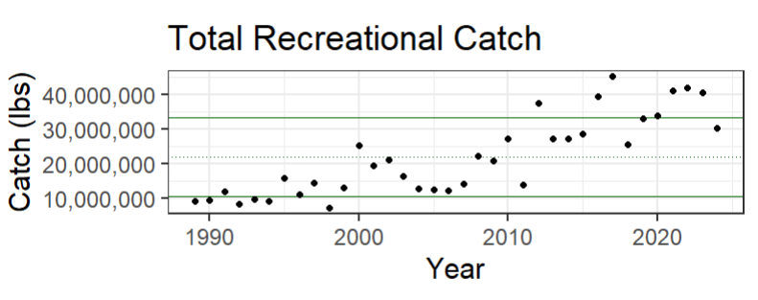
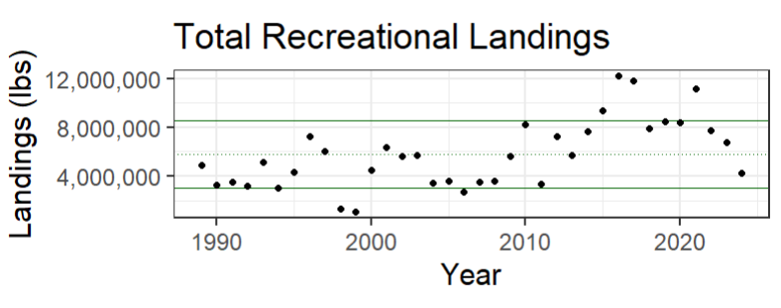
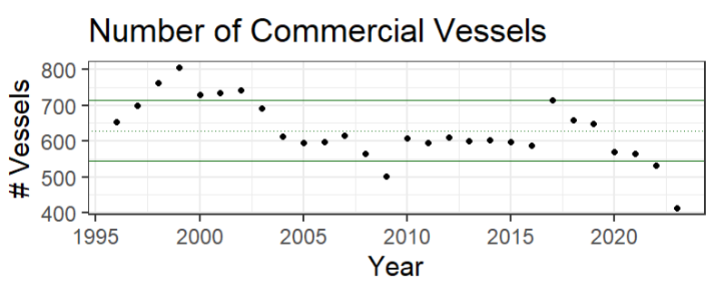
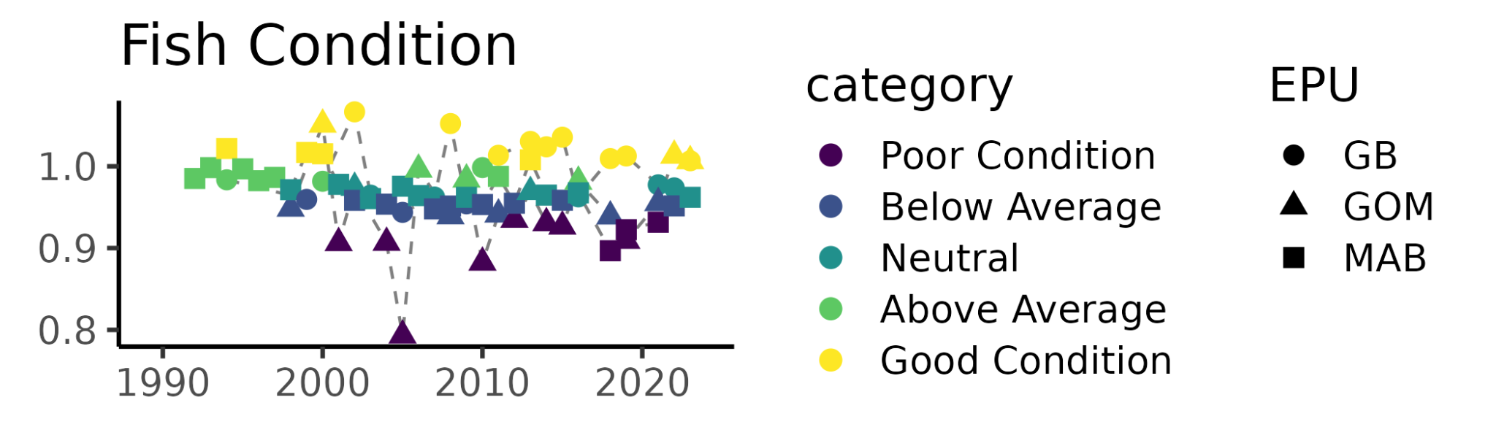
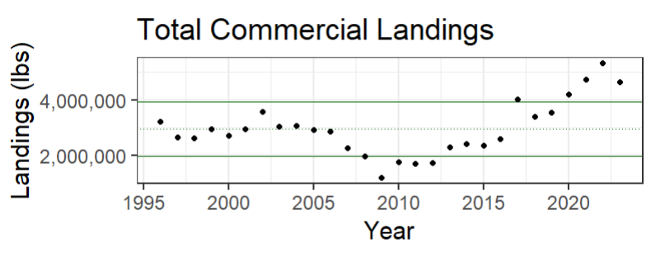
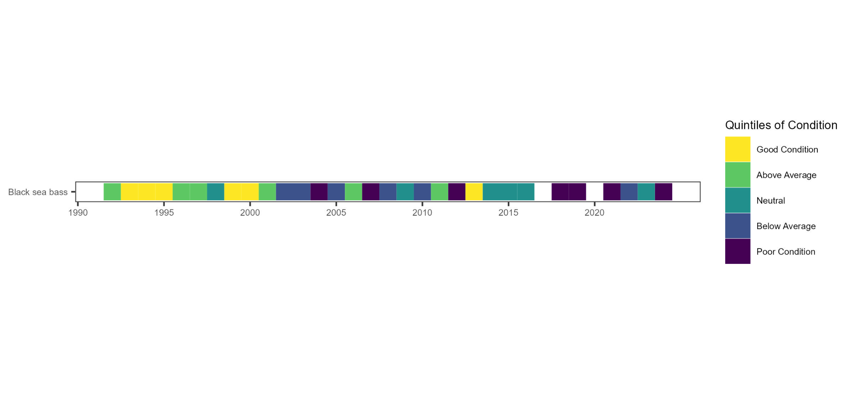
INDICATORS
Socioeconomic
Ecosystem
Indicator | Status in 2024 | Implications
Mean winter bottom temperature (N) | Cold: below 8C | Cold winter temperatures may increase the mortality of young-of-the-year fish, resulting in a smaller 2023 year class
Mean winter bottom temperature (S) | Neutral: above 8C | Combined with cold temperatures in the northern region, may result in northern fish moving into the southern region during winter, leading to misallocation of catch between the northern and southern stock subunits
Recreational trips | High | Important recreational fish
Recreational catch | Neutral/high | Important recreational fish
Recreational landings | Neutral/Low | Catch-and-release fishery
Commercial catch | High | Growing commercial value of black sea bass
Commercial vessels participating in fishery | Low | Black sea bass may be increasingly important for vessels that remain engaged in the fishery
DATA GAPS AND RESEARCH PRIORITIES
define better response variable to measure (indicator) the extent of winter mixing and the movement of northern fish to areas south of Hudson Canyon
Do not have most recent years for SWV data
Caveats with data sources used to create indicators
U.S. Department of Commerce | National Oceanic and Atmospheric Administration | National Marine Fisheries Service

Slide 10
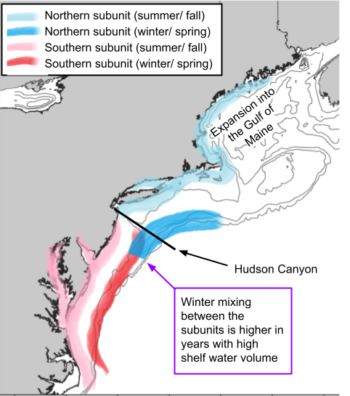
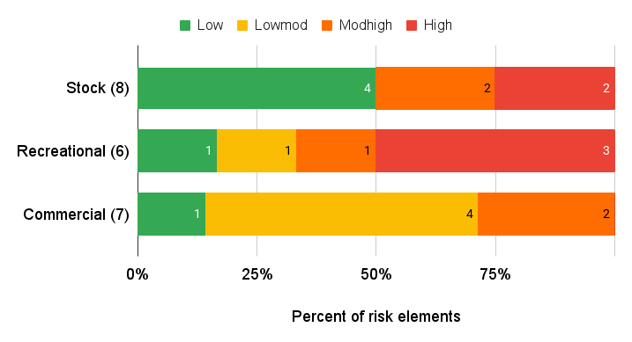
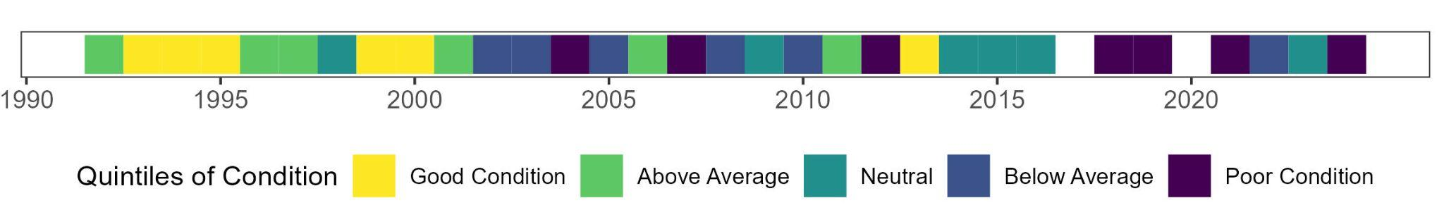
Black Sea Bass (Centropristis striata)
Ecosystem & Socioeconomic Profile Report Card
Northeast Fisheries Science Center
March 2025
2024 IN REVIEW
Colder than normal winter temperatures in 2024 may have caused high overwinter mortality of young-of-the-year black sea bass, leading to a smaller 2023 year class
Winter mixing between the northern and southern subunits may impact ____; mixing is higher in years with less suitable winter habitat (i.e., when the shelf slope front is further offshore and shelf water volume is larger).
Overfishing is not occurring and the stock is not overfished
Winter bottom temperature affects Recruitment
Cold winter for northern subunit fish but near average for the southern subunit (northern fish might have to travel further to find suitable winter habitat)
Something about condition in 2024
Socioeconomic takeaways - commercial
Socioeconomic takeaways - recreational
KEY POINTS FROM THE MID-ATLANTIC RISK ASSESSMENT
According to the 2024 Updated EAFM risk assessment in the Mid-Atlantic, Black Sea Bass have…
High vulnerability to climate
High risk of changing distributions; northward shift into the Gulf of Maine
High risk of not achieving optimal yield due to threats to estuarine habitat
High prey availability risk due to declines in both the biomass of benthic invertebrate prey and body condition
High risk to the recreational fishery due to catch exceeding harvesting limits in several years, regulatory complexity, and spatial mismatch of management bodies and locations of catch
Fish Condition
U.S. Department of Commerce | National Oceanic and Atmospheric Administration | National Marine Fisheries Service

Slide 11
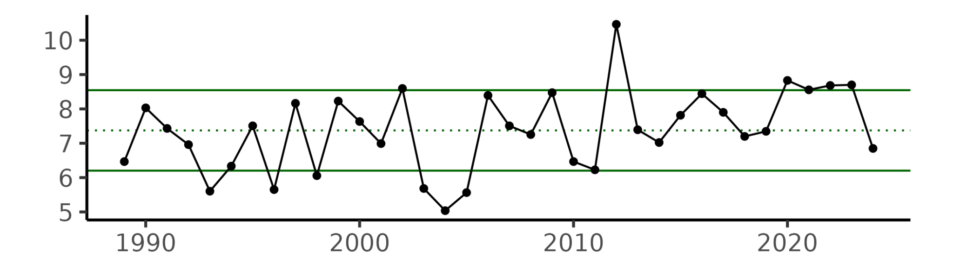
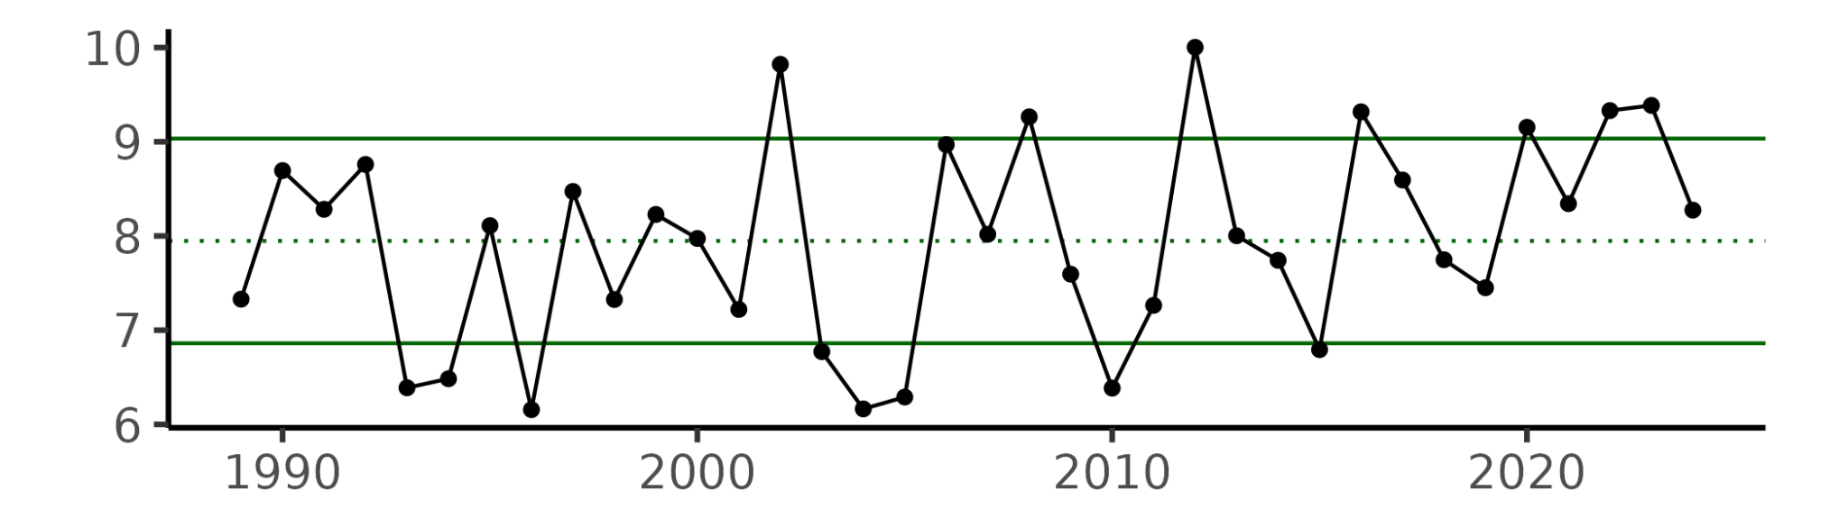
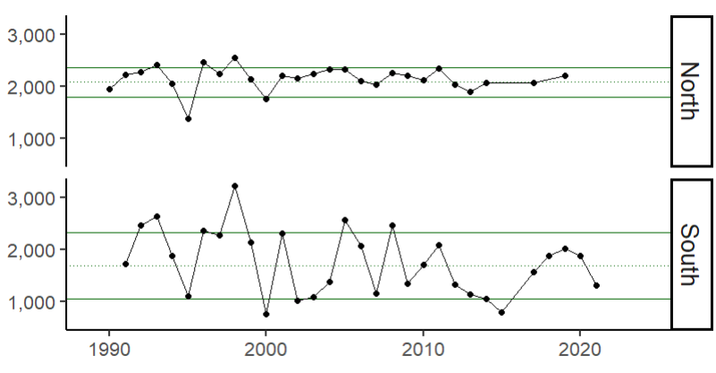
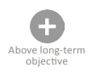
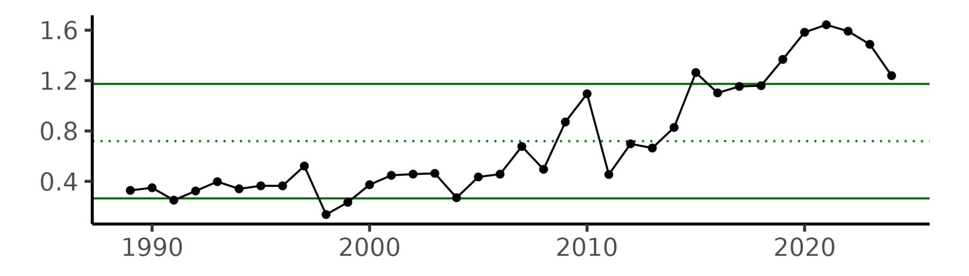
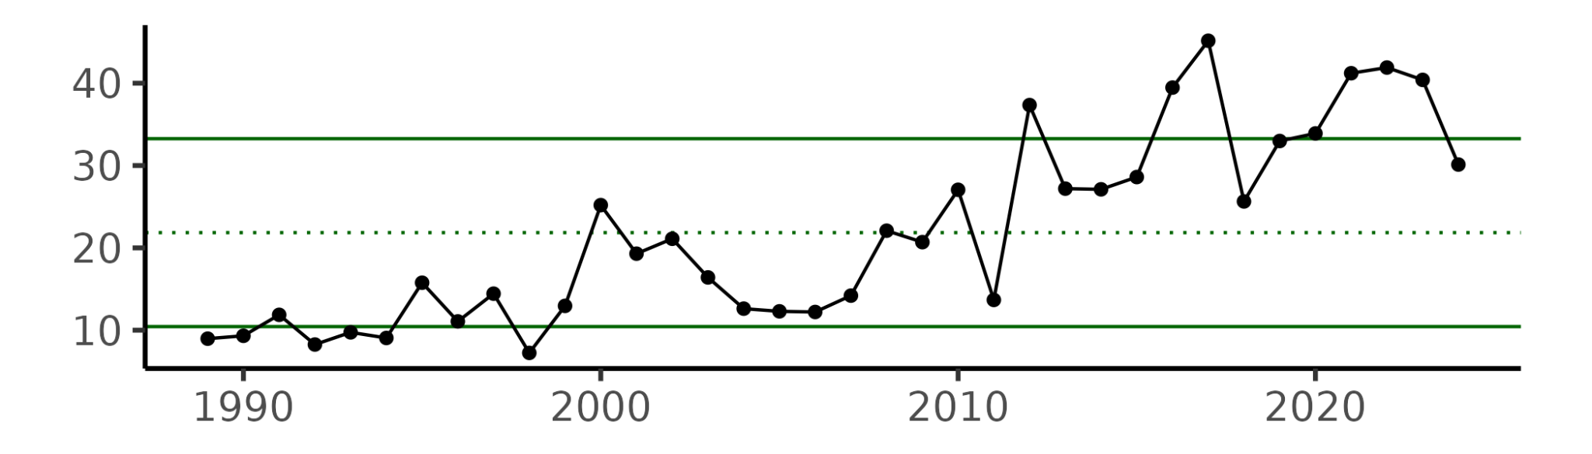
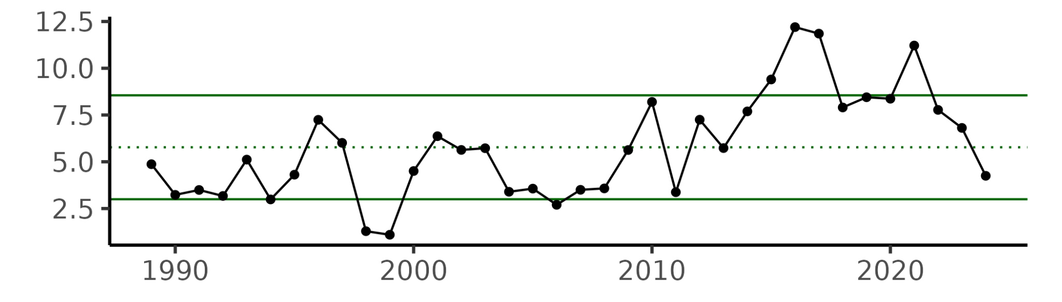
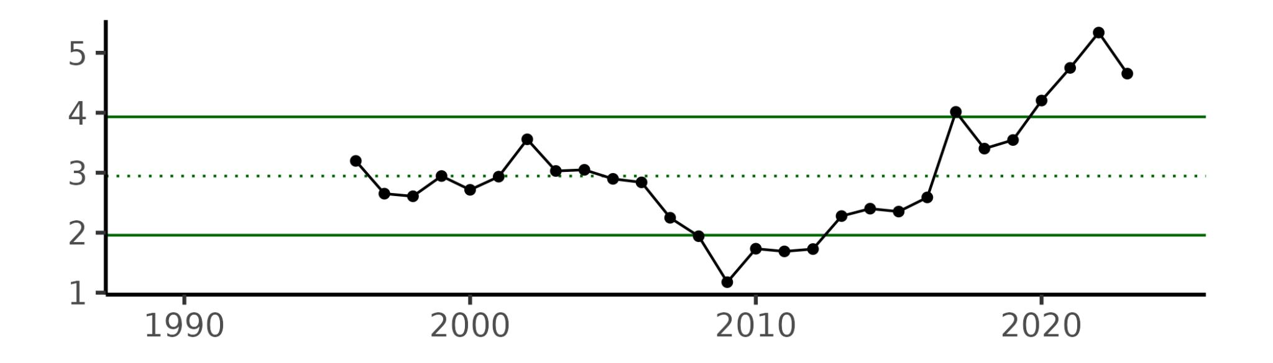
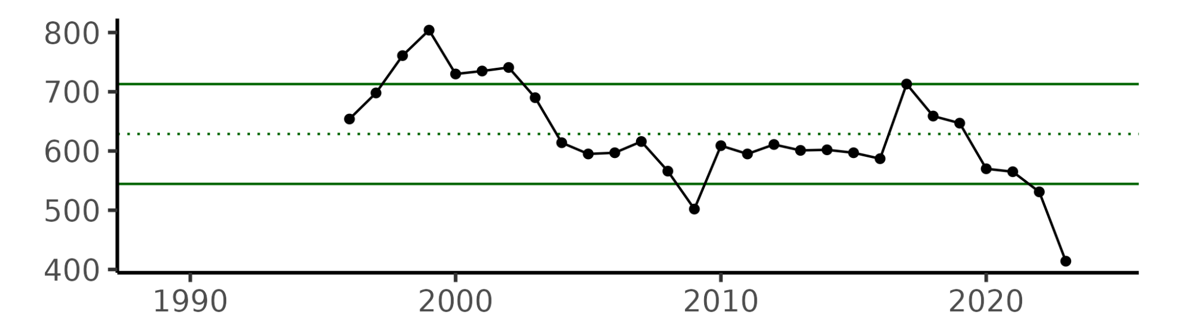
Indicator | Status in 2024 | Implications | Time Series
Mean winter (Feb-Mar) bottom temperature - North (°C) | Cold: below 8C | Cold winter temperatures may increase the mortality of young-of-the-year fish, resulting in smaller year classes. Bottom temperature data comes from GLORYS, a modeled product
Mean winter (Feb-Mar) bottom temperature - South (°C) | Neutral: above 8C | Combined with cold temperatures in the northern region, may result in northern fish moving into the southern region during winter, leading to potential misallocation of catch between the northern and southern stock subunits.
Shelf water volume (km³) | N/A (no data for 2024) | Shelf water volume is a proxy for suitable winter habitat. Shelf water volume dataset is created from in situ data and there has been no winter sampling since 2022; need additional indicators to inform stock subunit mixing
MRIP recreational trips (millions of annual trips) | High | Important recreational fish
MRIP recreational catch (millions of lbs) | Neutral/high | Important recreational fish
MRIP recreational landings (millions of lbs) | Neutral/Low | Catch-and-release fishery, recent management measures being implemented to reduce recreational harvest.
Commercial landings (millions of lbs) | High | Growing commercial value of black sea bass.
Number of commercial vessels (#) | Low | The number of active vessels landing black sea bass has been decreasing since 2017, which could impact revenue distributions and fleet diversity
Below threshold
U.S. Department of Commerce | National Oceanic and Atmospheric Administration | National Marine Fisheries Service

Slide 12
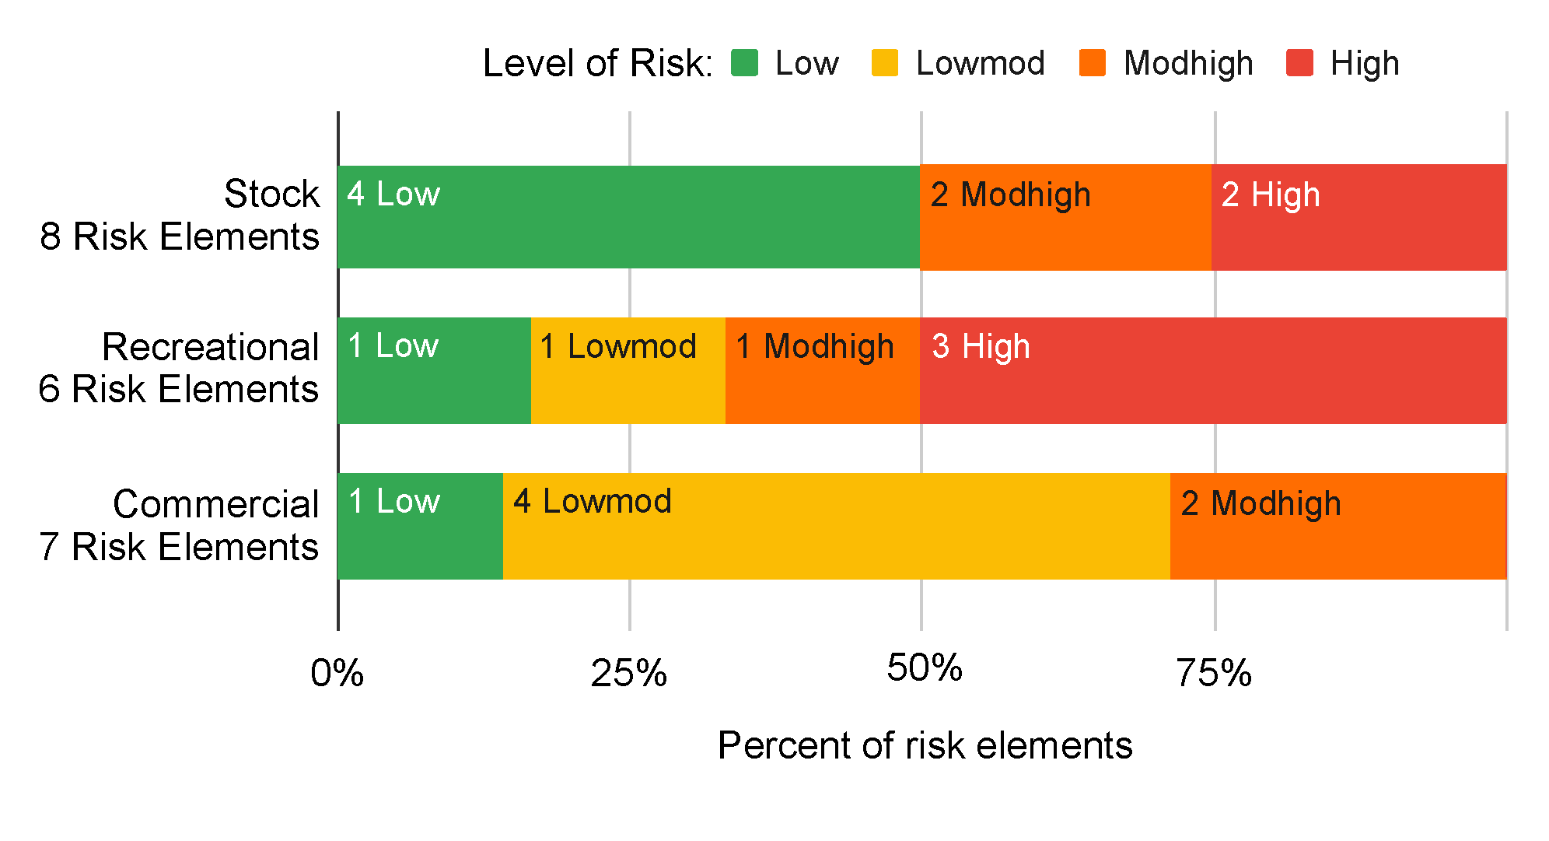
Black Sea Bass (Centropristis striata)
Ecosystem & Socioeconomic Profile Report Card
Northeast Fisheries Science Center
March 2025
HIGHLIGHTS
Two stock subunits
Shifting distribution
High commercial value & recreational engagement
STOCK STATUS
Overfishing is not occurring and the stock is not overfished
Something about regulatory changes?
ECOSYSTEM LINKAGES
Winter bottom temperature covariate on model recruitment
Shelf water volume is a proxy for suitable winter habitat
2024 IN REVIEW
Socioeconomic takeaways - commercial
Socioeconomic takeaways - recreational
Cold winter for northern subunit fish but near average for the southern subunit
Poor or below average fish condition in recent years
KEY POINTS FROM THE MID-ATLANTIC RISK ASSESSMENT
According to the 2024 EAFM risk assessment in the Mid-Atlantic, Black Sea Bass have …
High exposure to changes in climate
High risk of changing distributions; northward shift into the Gulf of Maine
High risk of not achieving optimal yield due to threats to estuarine habitat
High prey availability risk indicated by declines in both the biomass of benthic invertebrate prey and black sea bass body condition
High risk to the recreational fishery due to catch exceeding harvesting limits in several years, regulatory complexity, and spatial mismatch of management bodies and locations of catch
U.S. Department of Commerce | National Oceanic and Atmospheric Administration | National Marine Fisheries Service

Slide 13
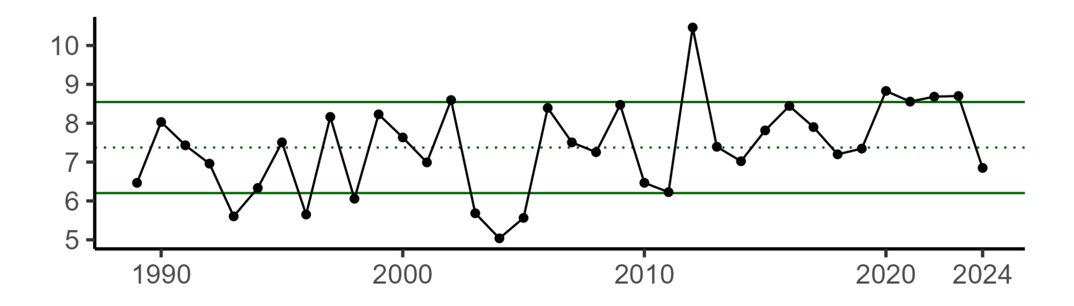





Indicator (units) | Status in 2024 | Implications | Time Series
Mean winter (Feb-Mar) bottom temperature - North (°C) |  | Cold winter temperatures may increase the mortality of young-of-the-year fish, resulting in smaller year classes. 2024 temperature was colder than black sea bass's lower threshold of 8C. Bottom temperature data comes from GLORYS, a modeled product.
Mean winter (Feb-Mar) bottom temperature - South (°C) |  | Combined with cold temperatures in the northern region, may result in northern fish moving into the southern region during winter, leading to potential misallocation of catch between the northern and southern stock subunits.
Shelf water volume (km³) | N/A (no data for 2024) | Shelf water volume is a proxy for suitable winter habitat. Shelf water volume dataset is created from in situ data and there has been no winter sampling since 2022; need additional indicators to inform stock subunit mixing
MRIP recreational trips (millions of annual trips) |  | Important recreational fish with recent trips near an all-time high. 2024 data is preliminary and does not include Wave 6 (November and December 2024). Catch generally reflects trip patterns. High regulatory complexity likely drives recreational fishing patterns.
MRIP recreational landings (millions of lbs) |  | Catch-and-release fishery, recent management measures being implemented to reduce recreational harvest. 2024 data is preliminary and does not include Wave 6 (November and December 2024).
Revenue per vessel |  | Growing commercial value of black sea bass.
Number of commercial vessels (#) |  | Black sea bass may be increasingly important for vessels that remain engaged in the fishery.
Below threshold
U.S. Department of Commerce | National Oceanic and Atmospheric Administration | National Marine Fisheries Service

Slide 14



Indicator (units) | Status in 2024 | Implications | Time Series
Mean winter (Feb-Mar) bottom temperature (°C) Northern subunit: North of Hudson Canyon Southern subunit: South of Hudson Canyon | North: | Cold winter temperatures may increase the mortality of young-of-the-year fish, resulting in smaller year classes. Additionally, cold temperatures may cause northern fish to move into the southern subregion, leading to potential misallocation of catch between the northern and southern stock subunits. 2024 temperature in the northern subunit (north of Hudson Canyon) was colder than black sea bass's lower threshold of 8C. Bottom temperature data comes from GLORYS, a modeled product.
Shelf water volume (km³) Northern subunit: North of Hudson Canyon Southern subunit: South of Hudson Canyon | N/A (no data for 2024) | Shelf water volume is a proxy for suitable winter habitat; higher shelf water volume indicates less suitable habitat, potentially leading to northern fish migrating into the southern subregion. The shelf water volume dataset is created from in situ data and there has been no winter sampling since 2022, highlighting the need for additional indicators to inform stock subunit mixing.
MRIP recreational trips (millions of annual trips) | Above long term average | Recent trip numbers are near an all-time high, but may have decreased from 2023 (2024 data is preliminary and does not include November and December 2024). Catch generally reflects trip patterns. High regulatory complexity is likely contributing to recreational fishing trends; the Mid Atlantic Risk Assessment highlights regulatory complexity for black sea bass as an important risk element.
MRIP recreational landings (millions of lbs) |  | The recreational black sea bass fishery has a catch-and-release component, and recent management measures are being implemented to reduce recreational harvest. 2024 data is preliminary and does not include November and December 2024.
Revenue per vessel (2023 USD) | Above long term average | Revenue per vessel has followed an overall increasing trend, suggesting potentially favorable returns in the fishery, despite decreases in both total landings and average price ($/lb; not shown)
Number of commercial vessels (#) |  | The number of active vessels has been decreasing since 2017, which could impact revenue distributions and fleet diversity.
Below threshold
South:
U.S. Department of Commerce | National Oceanic and Atmospheric Administration | National Marine Fisheries Service | Northeast Fisheries Science Center

Slide 15



Black Sea Bass (Centropristis striata)
Ecosystem & Socioeconomic Profile Report Card
Spring 2025
BACKGROUND
Overfishing is not occurring and the stock is not overfished
Two stock subunits, divided at the Hudson Canyon
High commercial value & recreational engagement
Winter bottom temperature is a covariate on modeled recruitment
2024 IN REVIEW
Commercial Fishery:
Number of active vessels declined in 2024, but total landings increased from 2023
Total revenues decreased slightly along with average prices ($/lb)
Average revenue per vessel increased, following an upward trend over the past three years for vessels that remain in the fishery
Recreational Fishery:
Number of targeted trips, catch, and landings all down from 2023
Number of trips remains above the historic average
Not clear if catch per angler has continued to increase in 2024
Ecosystem:
Cold winter in northern subunit but near average in southern subunit
Poor or below average fish condition in recent years
KEY POINTS FROM THE MID-ATLANTIC RISK ASSESSMENT
According to the Mid-Atlantic 2024 EAFM risk assessment update, Black Sea Bass scored high and moderately high risk in the following elements:
Moderate-high to high risk to the stock due to:
Very high exposure to changes in climate
Observed and potential changes in distribution; northward shift into the Gulf of Maine
Threats to estuarine habitat
Decline in the biomass of benthic invertebrate prey
Decline in black sea bass body condition in the Mid Atlantic Bight
High risk to the recreational fishery due to:
Catch exceeding harvest limits in several years
High regulatory complexity (frequent changes and varying interstate recreational regulations)
Spatial mismatch of management bodies and locations of catch; recent or ongoing council discussion about allocation
Moderate-high risk to the commercial fishery due to:
Offshore wind development and high discards
U.S. Department of Commerce | National Oceanic and Atmospheric Administration | National Marine Fisheries Service | Northeast Fisheries Science Center

Slide 16
Black Sea Bass (Centropristis striata)
Ecosystem & Socioeconomic Profile Report Card
Spring 2025
BACKGROUND
Overfishing is not occurring and stock is not overfished
Two stock subunits, divided at the Hudson Canyon
High commercial value & recreational engagement
Winter bottom temperature used as recruitment covariate
INDUSTRY PERSPECTIVE
High catch but low landings due to size restrictions
High availability but restrictive measures
Concerns about changing biomass outputs from model
Enforcement issues due to regulatory complexity
INDUSTRY PERSPECTIVE
2024 IN REVIEW
Commercial Fishery:
Number of active vessels declined in 2024, but total landings increased from 2023
Total revenue decreased slightly along with average prices ($/lb)
Average revenue/vessel increased, following an upward trend over the past three years for vessels that remain in the fishery
Recreational Fishery:
Number of targeted trips, catch, and landings all down from 2023
But number of trips still above the historic average
Not clear if catch per angler has continued to increase in 2024
Ecosystem:
Cold winter in the north but near average in the south
Poor or below average fish condition in recent years
KEY POINTS FROM THE MID-ATLANTIC RISK ASSESSMENT
According to the Mid-Atlantic 2024 EAFM risk assessment update, Black Sea Bass scored high and/or moderately high risk in the following elements:
Moderate-high to high risk to the stock due to:
Very high exposure to changes in climate
Observed and potential changes in distribution; northward shift into the Gulf of Maine
Dependence on estuarine/nearshore habitat
Decline in the biomass of benthic invertebrate prey
Decline in black sea bass body condition in the Mid Atlantic Bight
High risk to the recreational fishery due to:
Catch exceeding harvest limits in several years
High regulatory complexity (frequent changes and varying interstate regulations)
Regulatory changes in allocations
Moderate-high risk to the commercial fishery due to:
Significant commercial revenue in wind development areas
High discards & discard mortality
U.S. Department of Commerce | National Oceanic and Atmospheric Administration | National Marine Fisheries Service | Northeast Fisheries Science Center

Slide 17




Slide 18







Alternate maps
A)
MAB shapefile
BSB shapefile
MAB/BSB shapefile
B)

